Slide 1
Advanced Offline Servicing Windows 10 Server 2016 / 2019
@SeguraOSD
https://www.osdeploy.com

Slide 2
About the Speaker
20+ years in Enterprise OS Deployment
Expert in Enterprise OS Deployments
ConfigMgr, MDT, and Offline Deployments
Expert in Enterprise OS Customization
Custom Deployment Scripts and Group Policy
PowerShell and VBS geek
Presented at CTSMUG (Aug/Oct) and DFWSMUG (Aug)
Nominated for Microsoft MVP
https://www.osdeploy.com

Slide 3
What is Offline Servicing?
https://www.osdeploy.com

Slide 4
What is Offline Servicing?
Process of mounting a Windows Image and injecting updates Offline
https://www.osdeploy.com/osbuilder/knowledge/offline-servicing

Slide 5
Offline Servicing Process
Mount a WIM
Install Servicing Stack and Cumulative Updates
Install Setup and Component Updates
Install Adobe Security Updates
Optionally add Drivers, Remove Appx Packages, etc
Save WIM Changes
https://www.osdeploy.com/osbuilder/knowledge/offline-servicing

Slide 6
Why do I need to do this?
MVLS Images are Out of Date
Updates during OS Deployment take a long time
Updating Multi-Index Operating Systems in CM
Upgrades will fail with Out of Date Operating Systems
https://www.osdeploy.com

Slide 7
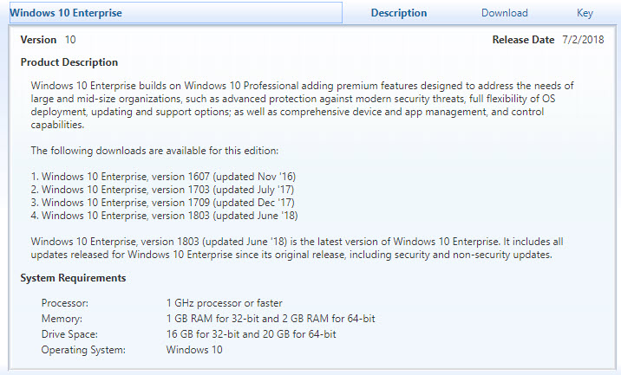
MVLS Images are not Updated
https://www.osdeploy.com/osbuilder/knowledge/offline-servicing

Slide 8
Windows 10 Upgrade Task Sequence Issues
DeviceMap and Device Inventory Failures in Win7 to Win10 1709 In-Place Upgrades
@surferstylee13
http://blog.ctglobalservices.com/configuration-manager-sccm/mag/devicemap-and-device-inventory-failures-in-win7-to-win10-1709-in-place-upgrades/
Windows 10 1709 In-Place Upgrade Hangs on Making Sure You're Ready to Install
@AdamGrossTX
http://www.asquaredozen.com/2018/05/21/windows-10-1709-in-place-upgrade-hangs-on-making-sure-youre-ready-to-install/
Both issues are caused by outdated Dynamic Updates!
https://www.osdeploy.com/osbuilder/knowledge/offline-servicing

Slide 9
OSBuilder PowerShell Module
PowerShell Gallery
https://www.powershellgallery.com/packages/OSBuilder
Install-Module –Name OSBuilder –Scope CurrentUser
https://www.osdeploy.com/osbuilder/installation

Slide 10
Import-OSMedia
Extracts a single Index
Generates a full inventory of the Operating System
https://www.osdeploy.com/osbuilder/how-to/update-osmedia

Slide 11
Monthly OS Update Cycle
Import
OS Media
Update
OS Media
Customize OS
Customized
OS Build
Download New Updates
Download New Updates
Update
OS Media
Customize OS
Customized
OS Build
Download New Updates
Update
OS Media
Customize OS
Customized
OS Build

Slide 12
Update-OSMedia
Apply Servicing Stack Updates
Apply Cumulative Updates
Apply Adobe Security Updates
Apply Component Updates
Apply Setup Updates
Apply Updates to WinPE, WinRE, and Setup
https://www.osdeploy.com/osbuilder/how-to/update-osmedia

Slide 13
New-OSBuild
Enable NetFX3
Remove Packages and Appx Packages
Enable and Disable Windows Optional Features
Remove Windows Capability
Install Features on Demand
Install Language Packs, Language Interface Packs, Language Features On Demand
https://www.osdeploy.com/osbuilder/how-to/new-osbuildtask

Slide 14
New-OSBuild
Apply Unattend.xml
Import StartLayout.xml
Inject Drivers (including WinPE)
Add Extra Files (including WinPE)
Execute custom PowerShell Scripts (including WinPE)
Add Microsoft DaRT to WinPE
Add ADK Packages to WinPE Wims
https://www.osdeploy.com/osbuilder/how-to/new-osbuildtask

Slide 15
Other OSBuilder Features
Full Logging of all actions
Automatic Download of Updates
Task Based
Create a Bootable ISO
Create a Bootable USB
https://www.osdeploy.com/osbuilder/pebuild

Slide 16
New-PEBuild
Create a Recovery Image
Create a WinPE Boot Image
Create an MDT Boot Image
DaRT can be applied to all Boot Images
Drivers, Extra Files, Custom Scripts, ADK Packages . . .
https://www.osdeploy.com/osbuilder/pebuild

Slide 17
OSBuilder Demo
https://www.osdeploy.com/osbuilder/overview

Slide 18
Q and A
https://www.osdeploy.com

Slide 19
Thank You HASMUG!
https://www.osdeploy.com

